Slide 1
Safety in the Classroom

Slide 2
Safety in the Classroom
Hands off, Feet off
This one is important. But why?
We have our own personal bubble that we are comfortable in. We must respect that others do too .
When we play with hands on or feet on people can get hurt more easily.
"Close enough - personal space"
"personal space camp read aloud'
Notes:
Read aloud is not great quality – see book powerpoint in staff shared

Slide 3
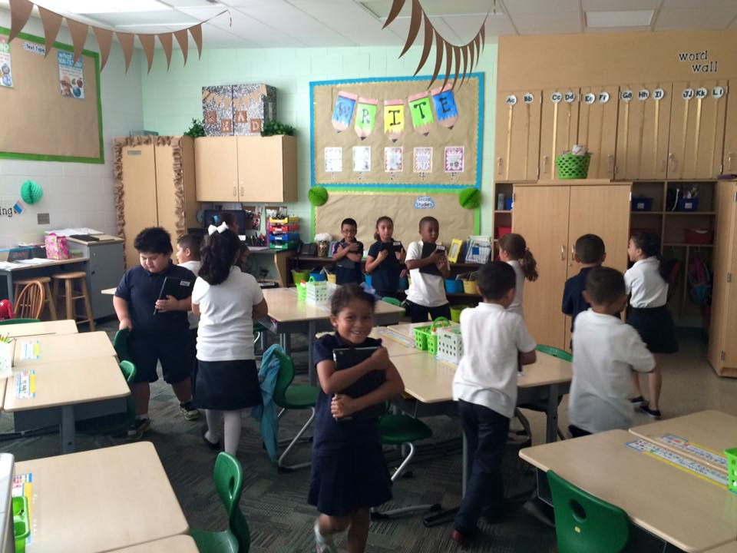
Safety in the Classroom
Walking in the Classroom
Why is walking in the classroom important?
If you fall, there are lots of things that you might bump into (scissors, pencils, chairs, desks, shelves)
There are many people in a small space and you might bump into someone else.

Slide 4
Safety in the Classroom
4 on the floor
Why do we ask for 4 on the floor?
If you chair tips over backwards you can hit your head. If it tips forward you can bang your chin
Your chair is made to have 4 legs on the floor so that it does not tip over easily
Others walking by your chair might trip on the legs if they are sticking out.

Slide 5
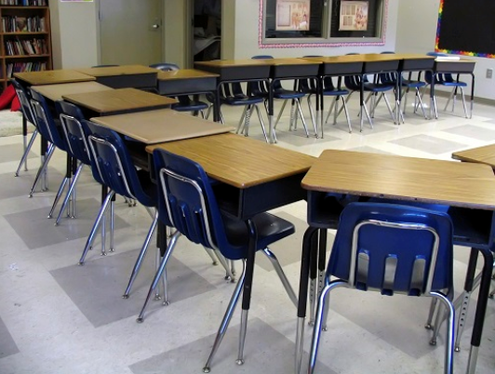
Safety in the Classroom
Chairs Pushed In
Why does it matter?
When chairs are left out they are something to trip over.
If there is a fire drill and chairs are left our, we may trip and create a new problem.

